Slide 1
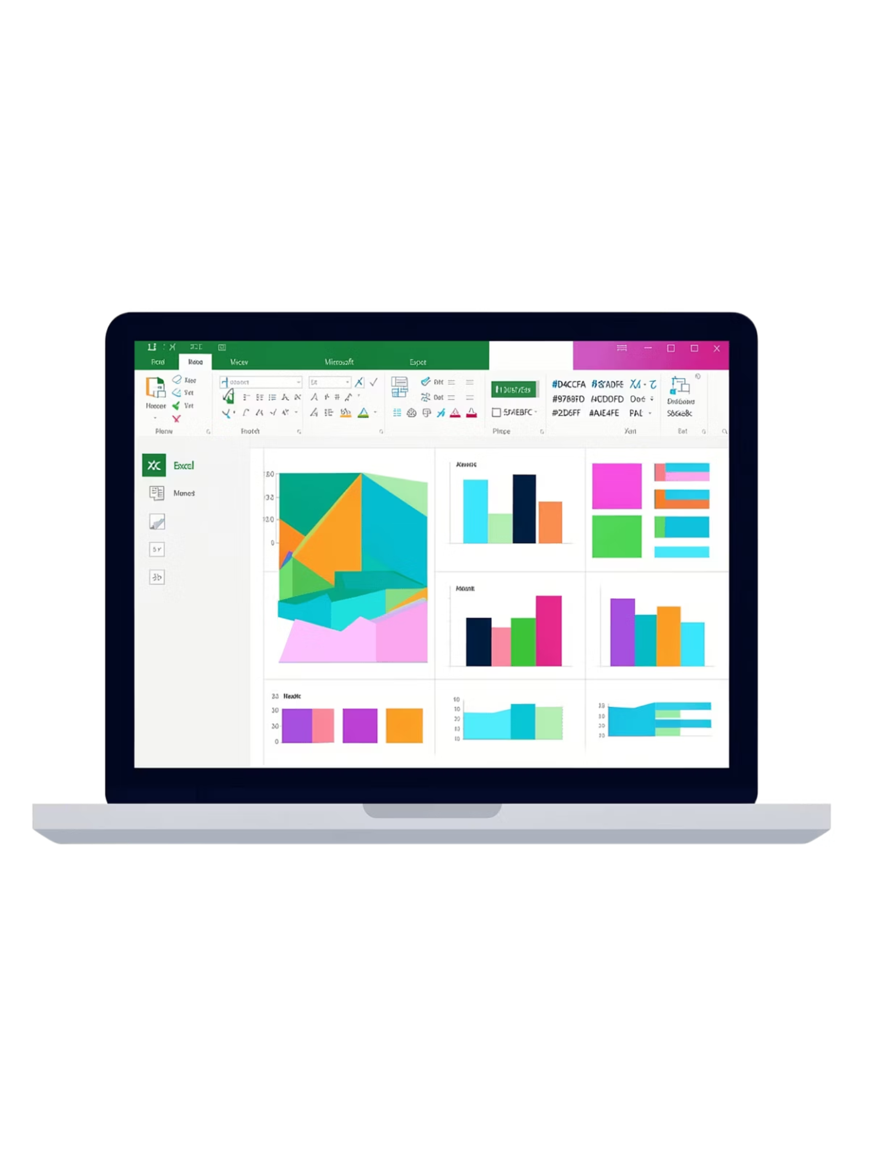
Sales & Profit Analysis
Using Microsoft Excel — Pivot Tables, Charts & Interactive Dashboard

Slide 2


Project Overview
Objective
Analyze sales and profit performance to identify trends in:
Sales & profits
Customer behavior
Category performance
Tools Used
Pivot Tables
Pivot Charts
Interactive Dashboard

Slide 3
Dataset Summary
Sales
Profit
Revenue figures per transaction
Profit margins by order
Category
State
Product categories
Geographic location
Customer
Order Date
Customer names
Year & Month

Slide 4

Data Cleaning & Preparation
Remove Duplicates
Format Columns
Eliminate repeated rows
Set types and formats
Handle Missing Values
Apply Filters & Sorting
Fill or remove blanks
Organize data for analysis
Excel tools used to ensure clean, consistent, and structured data before analysis.

Slide 5

Pivot Table Analysis
In this sales and profit analysis project, the pivot table reorganized raw sales records into a structured summary by category, state, customer, and order date. It made the dataset easier to compare and turned scattered transaction data into clear business insights.
Grouped the raw sales data by category, state, customer, and order date for analysis.
Calculated total sales of ₹19,28,888 and total profit of ₹2,47,961.
Highlighted Technology and Furniture as the top-performing categories.
Revealed regional sales variations across different states.
Identified the top customers contributing the most to sales.

Slide 6
Key Insights
₹19,28,888
₹2,47,961
Total Sales
Total Profit
Top Categories
Regional Variation
Top Customers
Technology & Furniture drove strong sales
Some states contributed more revenue than others
Generated higher profits for the business

Slide 7
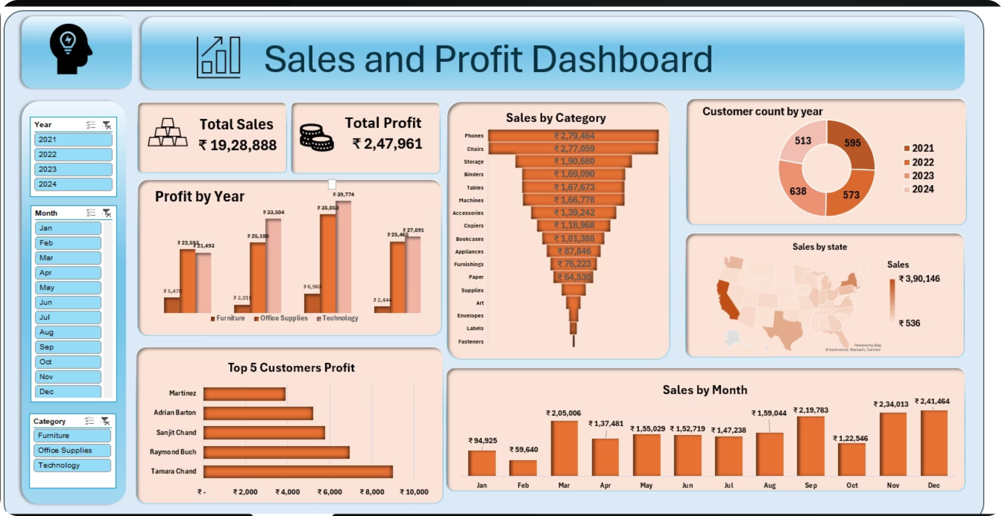
Dashboard & Recommendations
Focus on high-performing categories
Improve marketing in low-sales regions
Offer loyalty benefits to top customers
Use seasonal trends for planning

